Slide 1
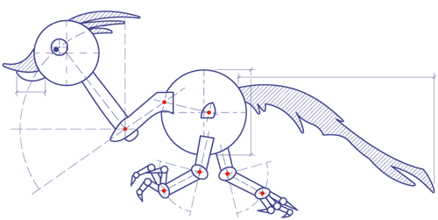
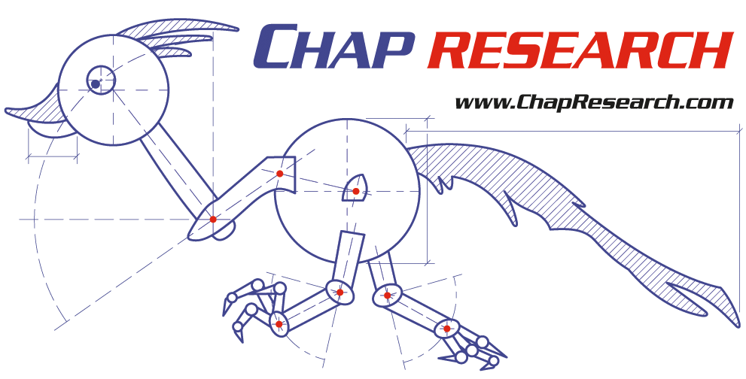
Rachel Gardner
A non-profit company promoting high-school innovation
Notes:
Mention non-proft

Slide 2
A framework for innovation
An after-school innovation program to help students learn real-world technical and entrepreneurial skills
Notes:
Our goal is to help students learn real-world technical and entrepreneurial skills not taught in school

Slide 3
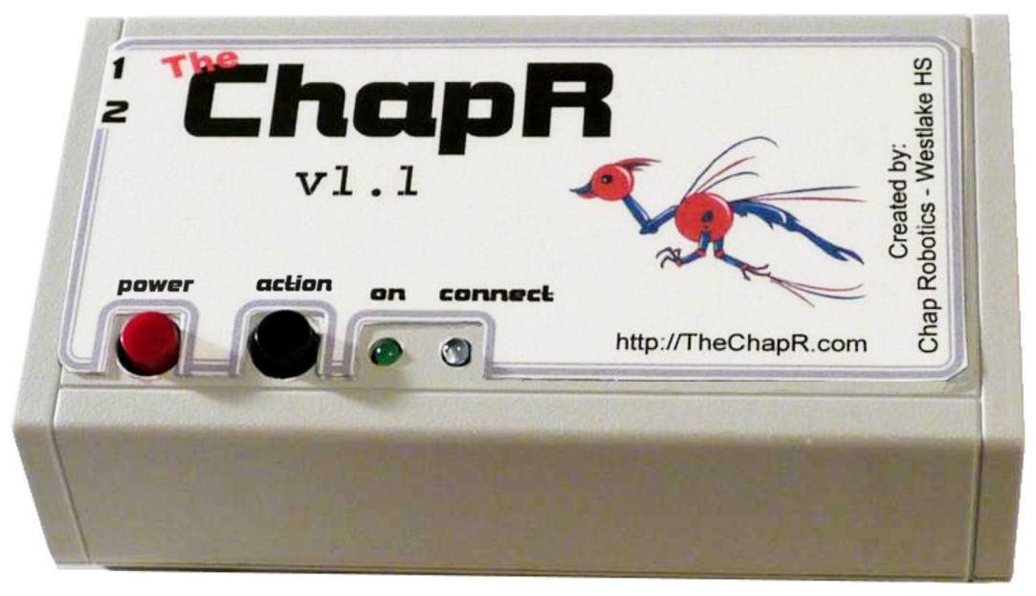
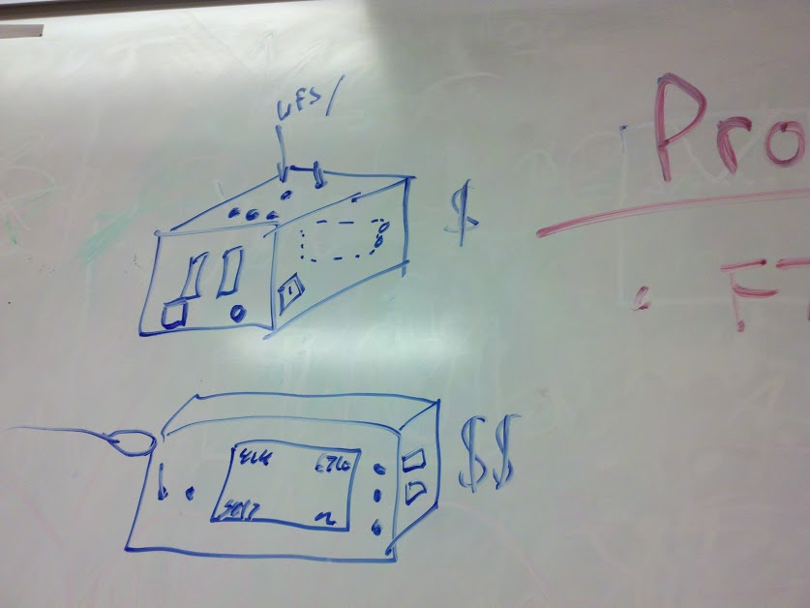
Why Make Chap Research?
To give students the experience and confidence to succeed in college and career settings
Notes:
Schools teach the basics, but cannot cover the entrepreneurial and research skills colleges and businesses require
This program uses experience-based learning to allow to students to start from scratch, working from a whiteboard and a couple of use cases to a complete product

Slide 4
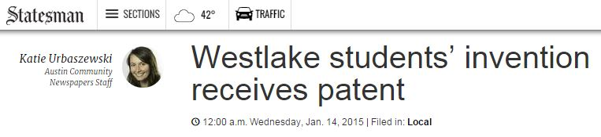
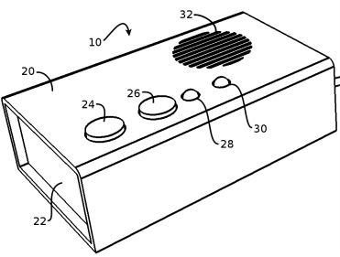
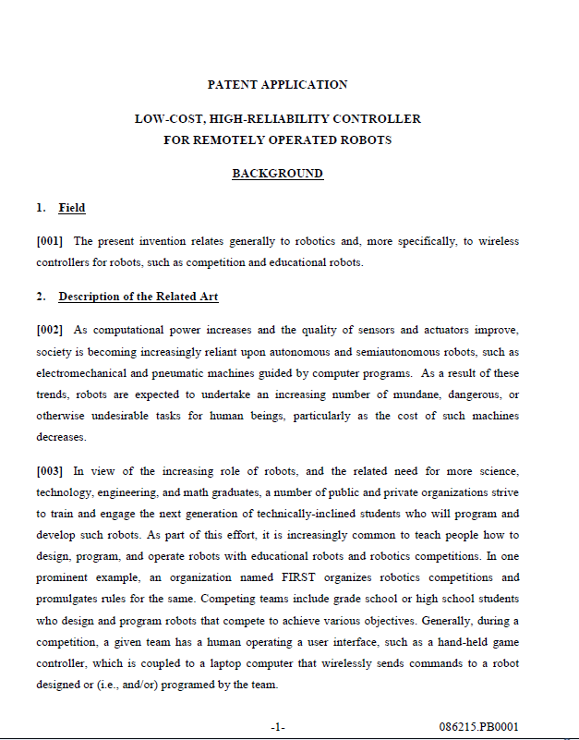
Why Make Chap Research?
To let students stand out
Notes:
Provides a way of recognizing students for their work by allowing them to earn patents, press coverage, internships, etc. It also acts as a framework for publishing and peer review of student-produced research papers and publications

Slide 5
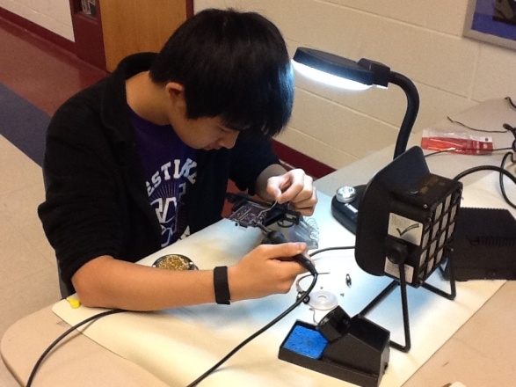
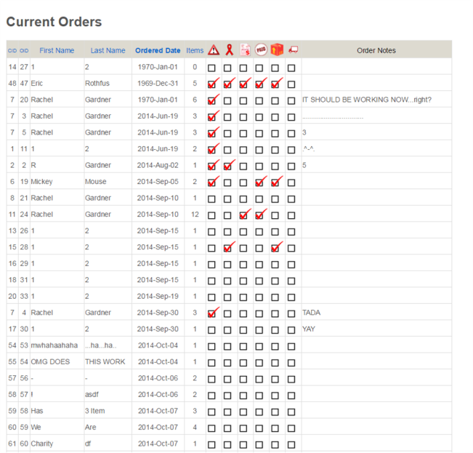
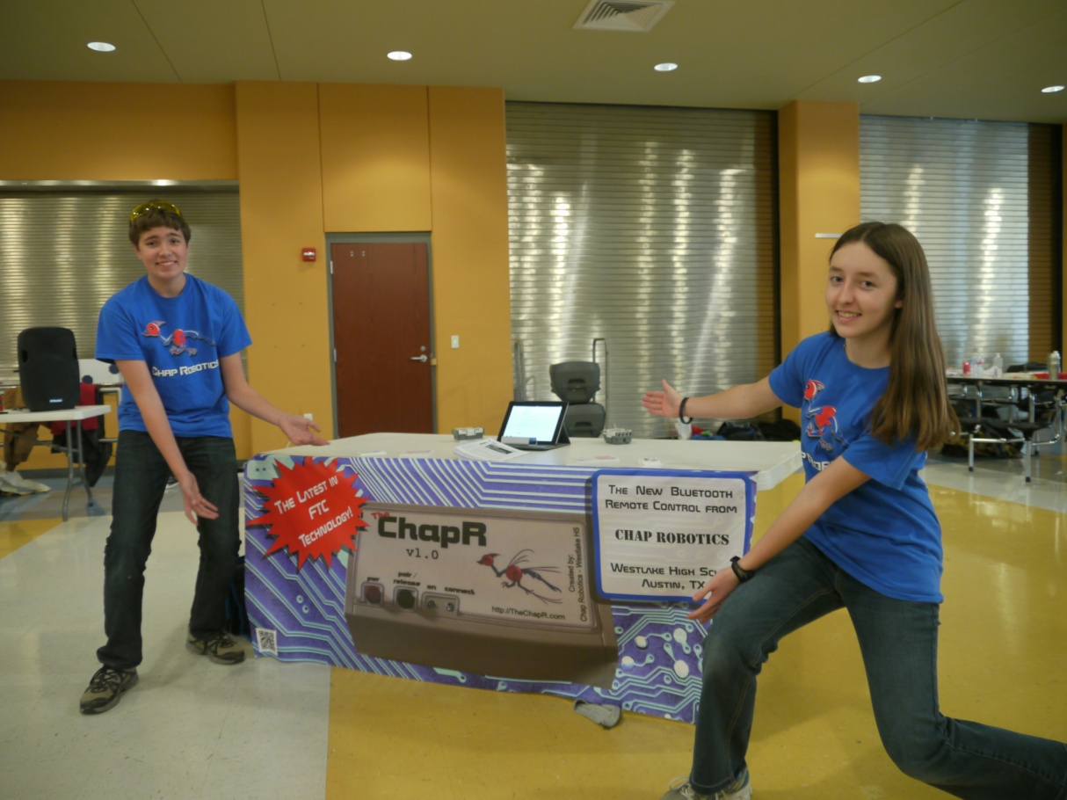
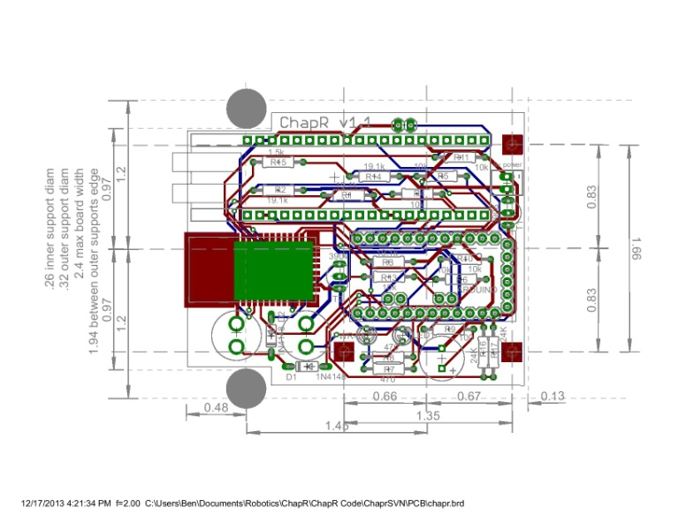
Why Make Chap Research?
To further explore/develop industry-applicable skills that are not taught in school
Notes:
Pitching to “investors”
Working with customers
Marketing products
Managing others
Applying for patents
Etc.
The skills we teach include everything from database design and manufacturing to marketing and working with customers. However, while we teach a variety of marketing skills, we still can’t make our students photogenic, as you can see here.

Slide 6
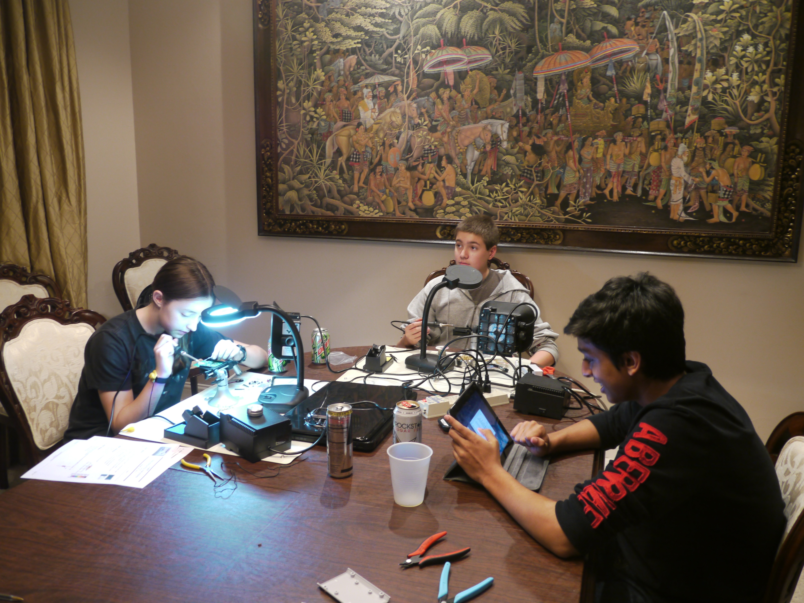
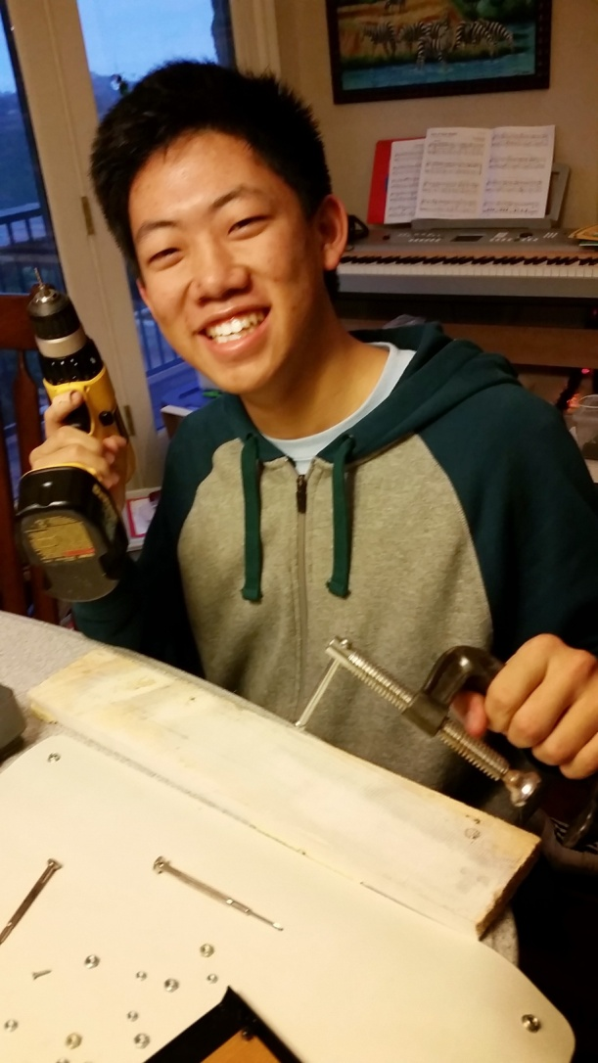
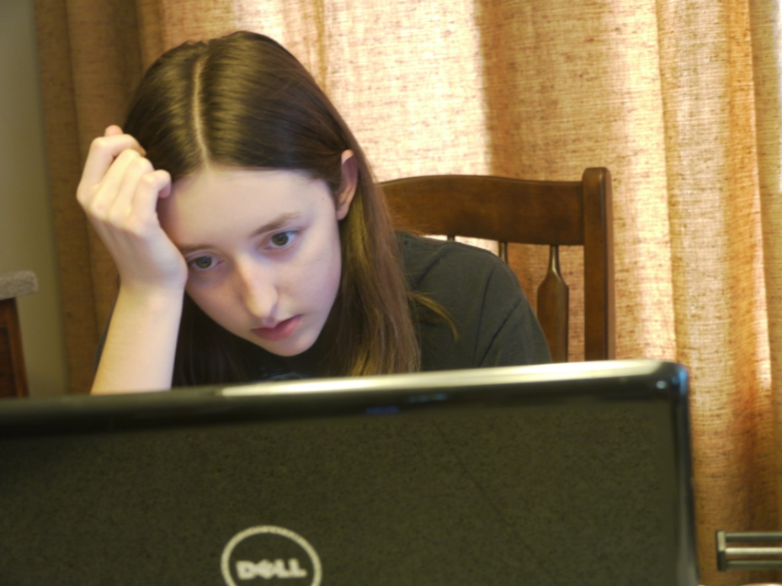
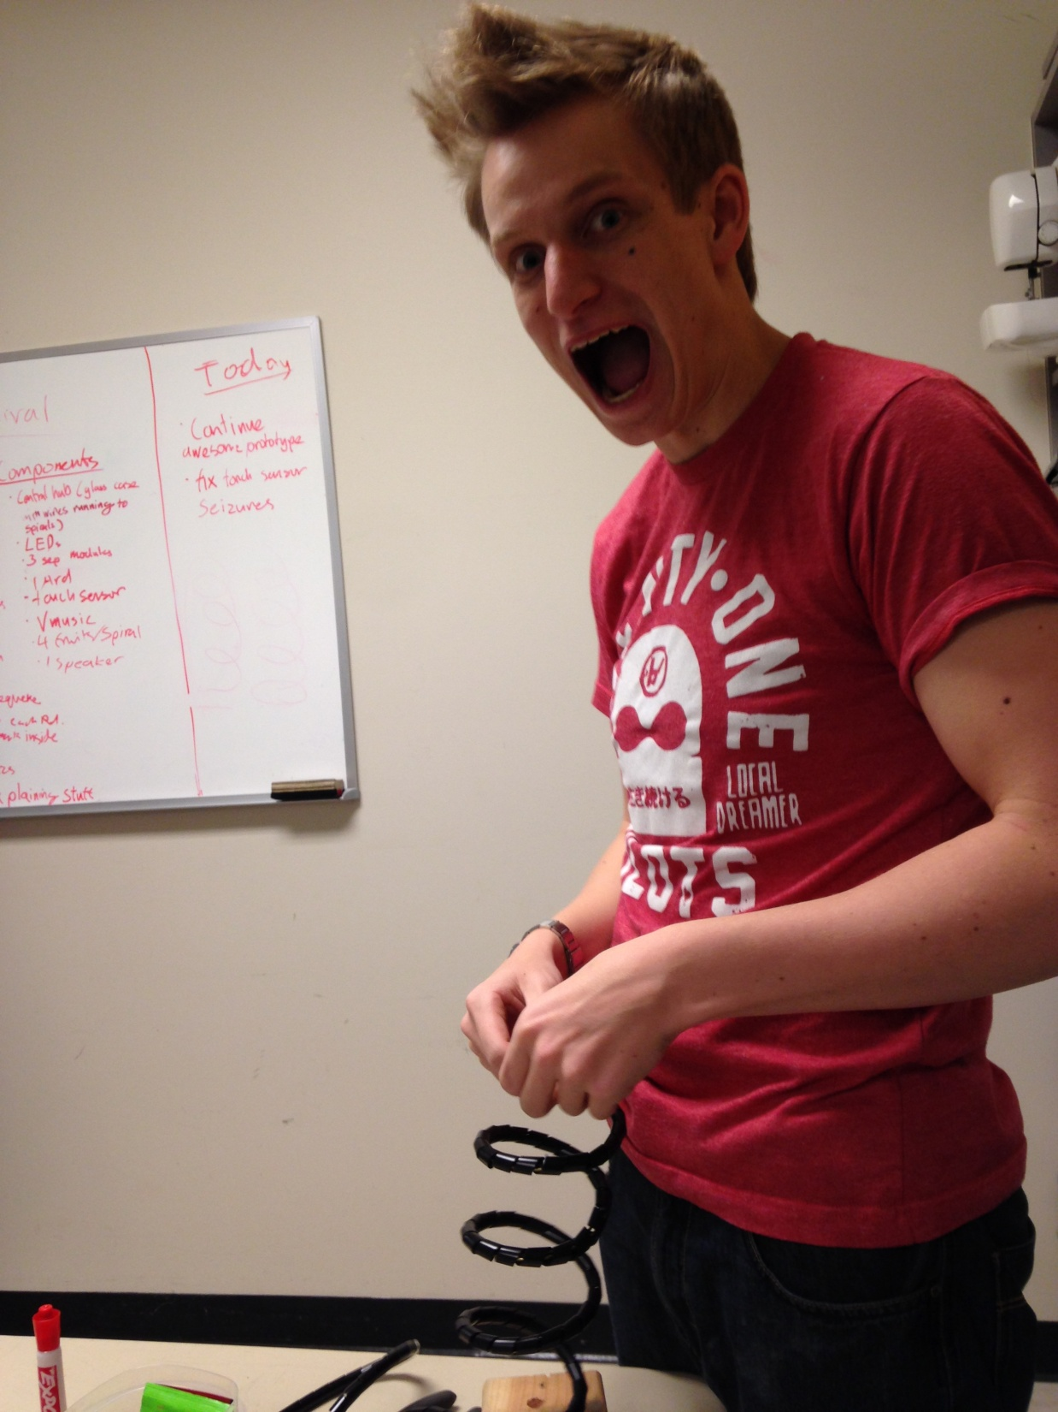
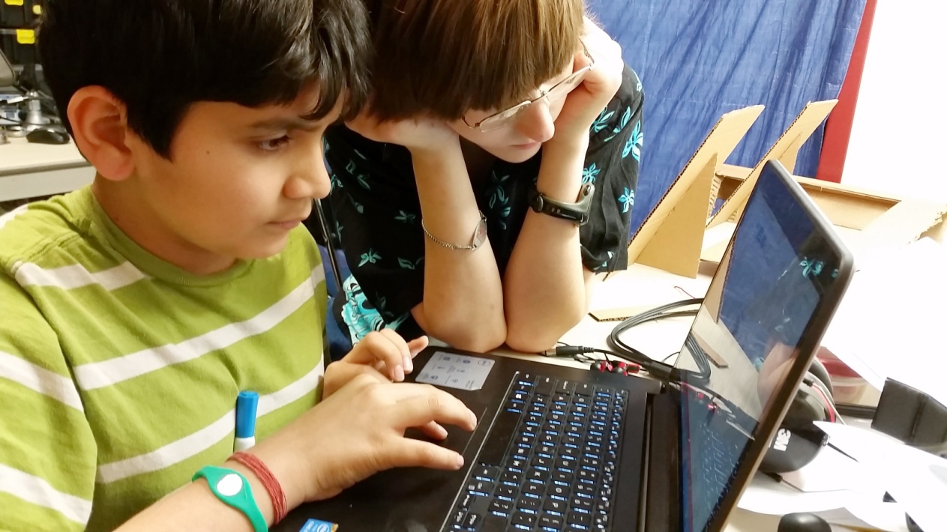
Why Make Chap Research?
To allow students to explore career choices and get excited about STEM
Notes:
Despite all this, Chap Research is also fundamentally about making students excited and engaged. [gestures to screen] Look at all these excited people. [transition] Most of them anyway. But on the other hand, having the perseverance to work through setbacks is just as important as having fun during the exciting parts.

Slide 7
Chap Research Works
The ChapR: a patented Bluetooth remote control for robots, created in 2013 as the first project of Chap Research.
Notes:
All of the benefits to the students that I’ve described were proven through our successful first project, the ChapR. By developing the ChapR, we realized we had more than a product; we had a process by which to allow students to develop innovation skills.

Slide 8

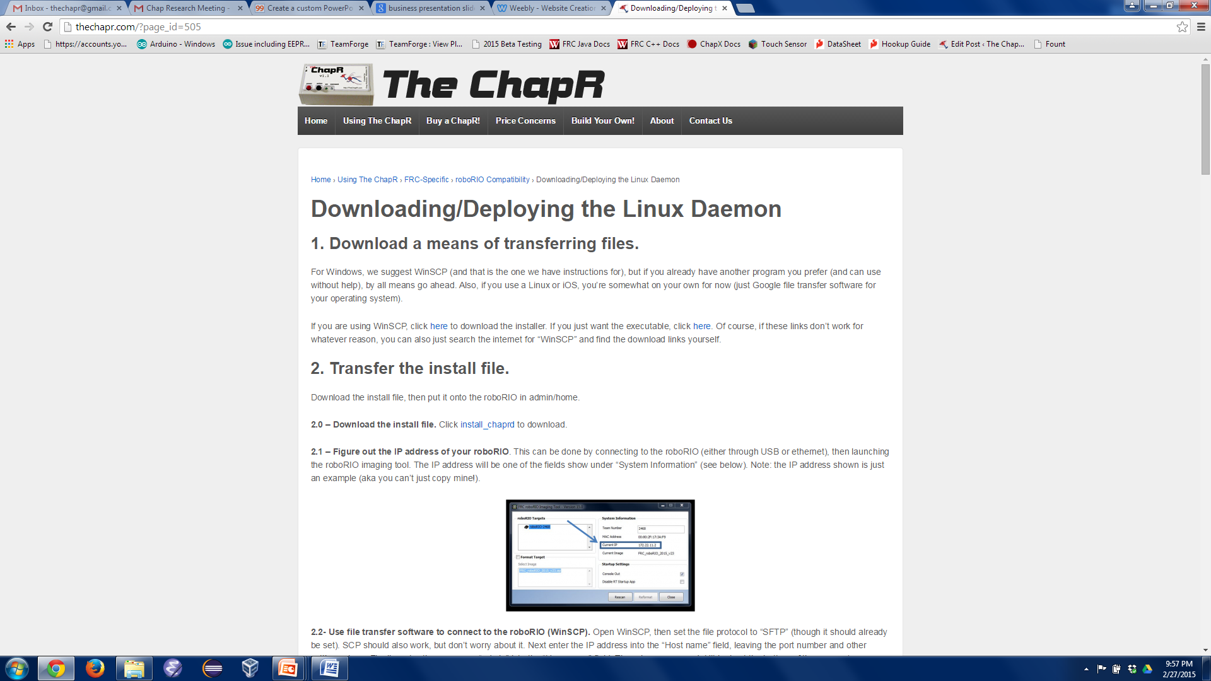

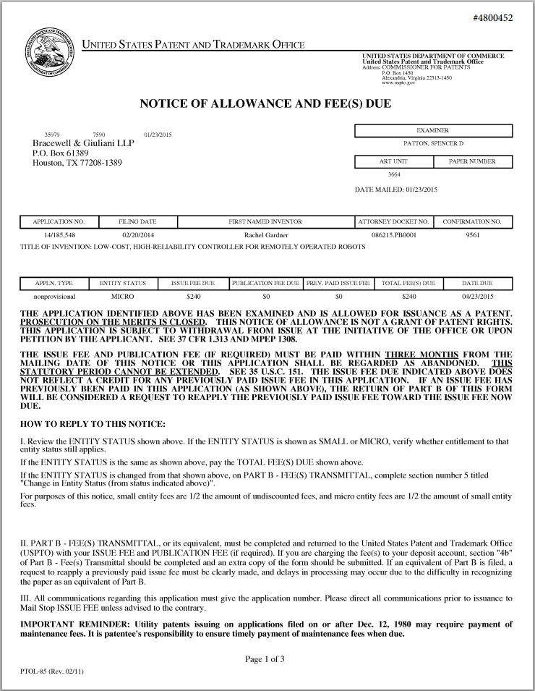
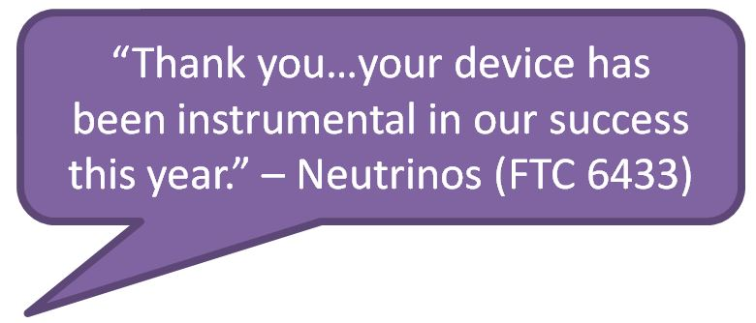
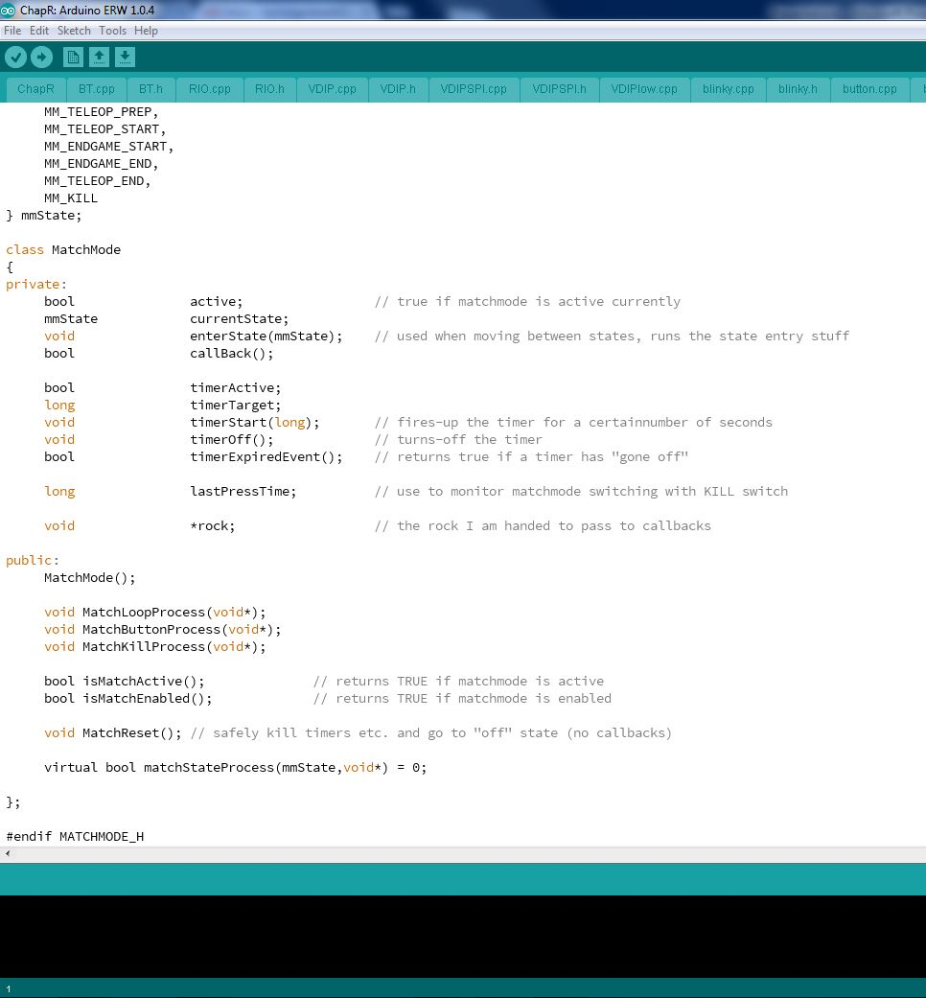
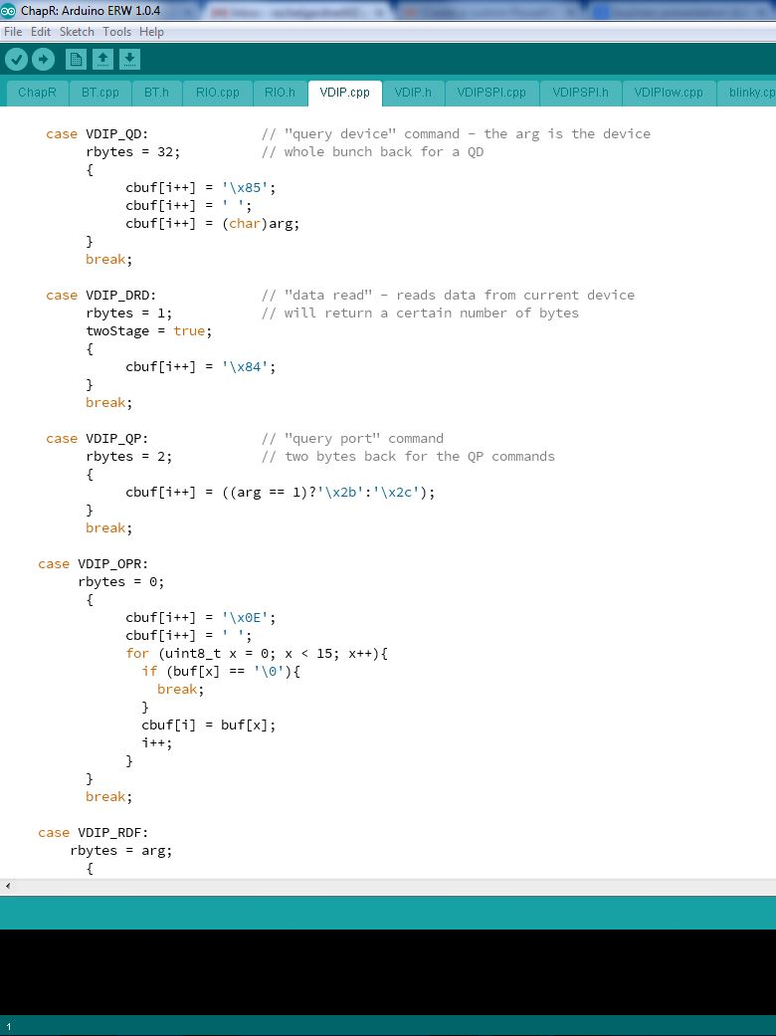
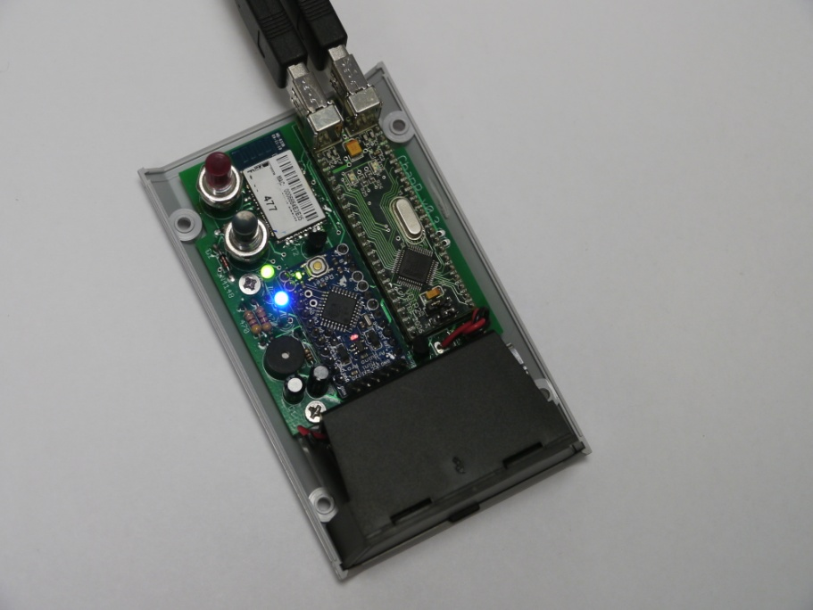
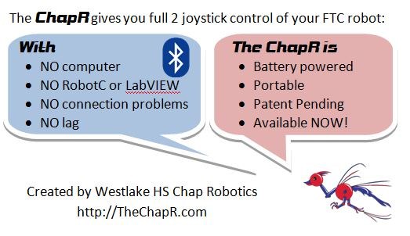
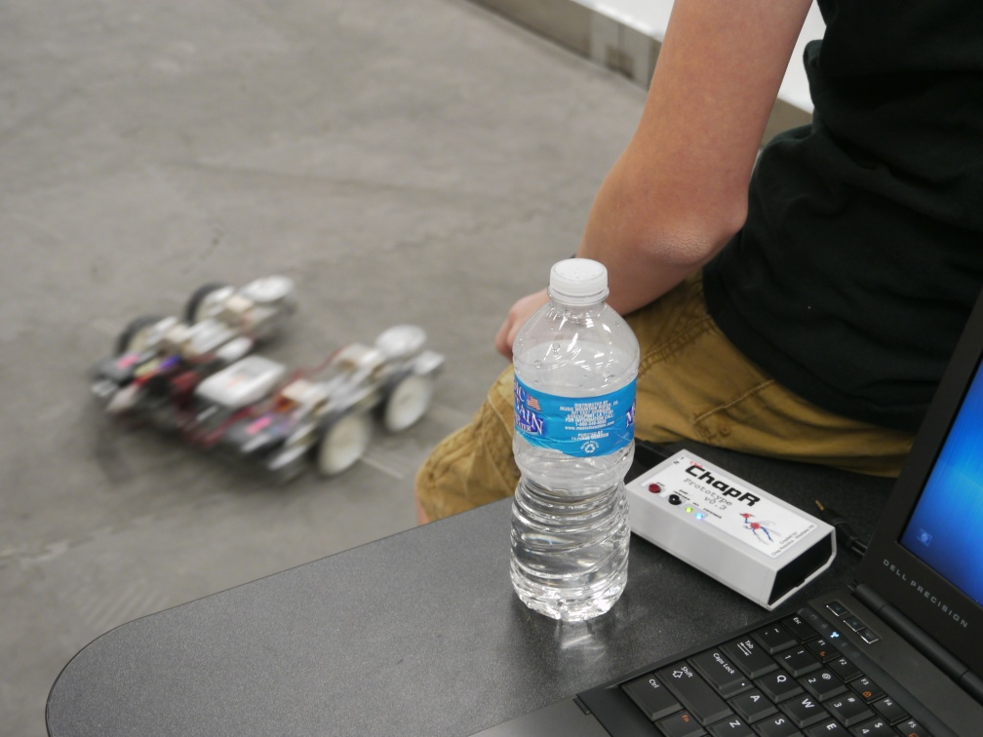
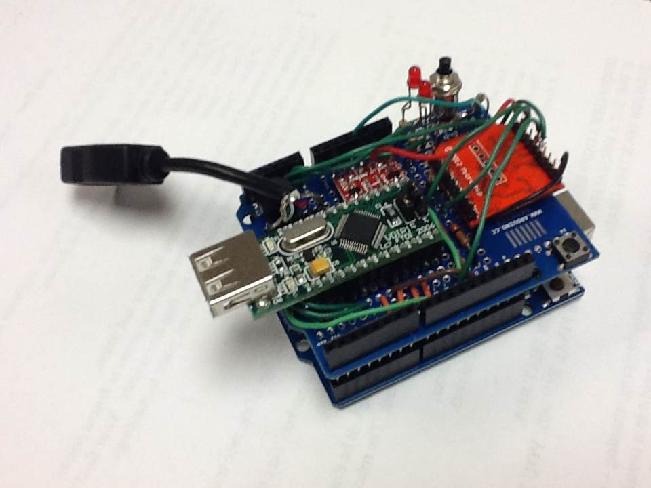
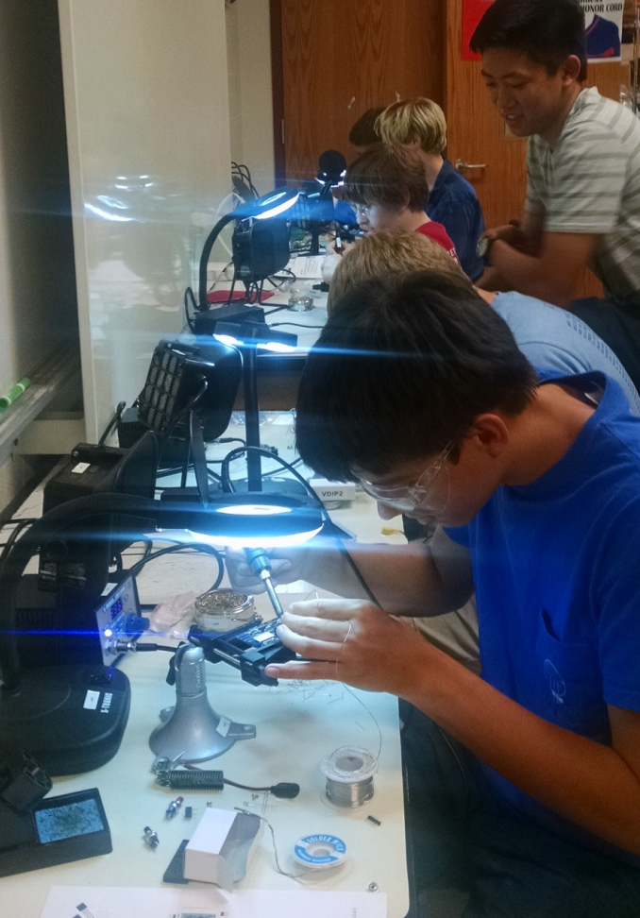
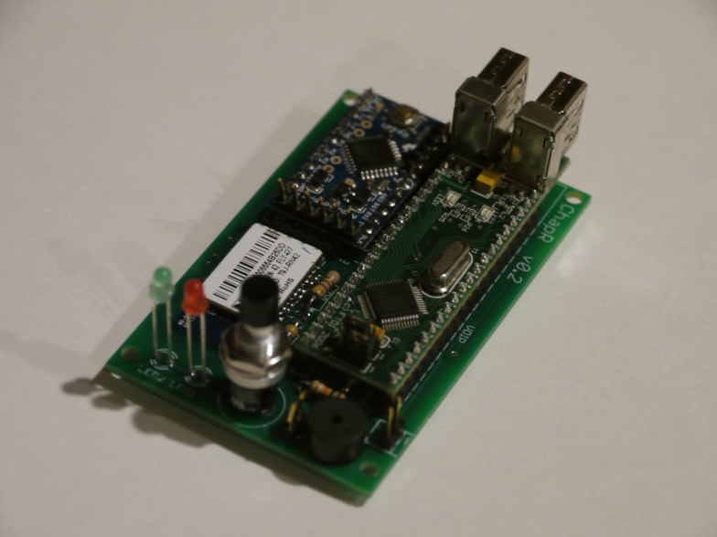
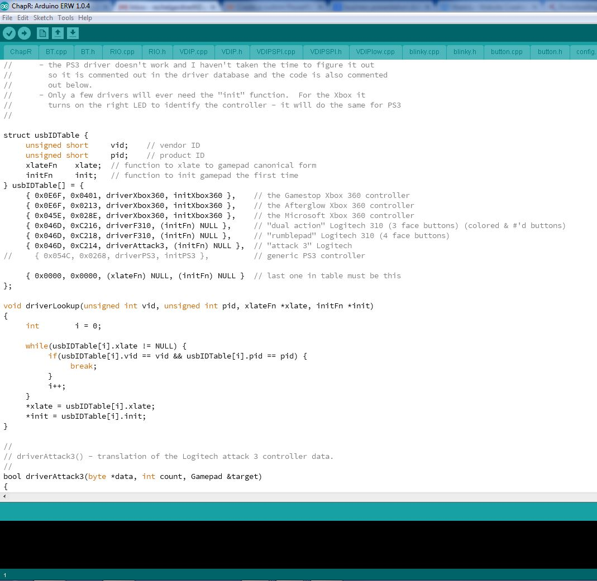
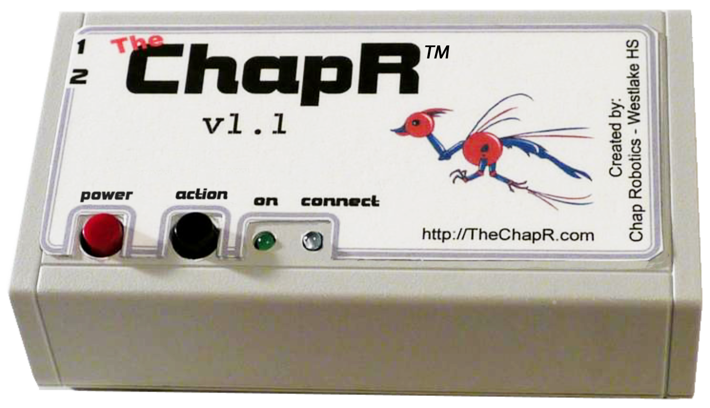
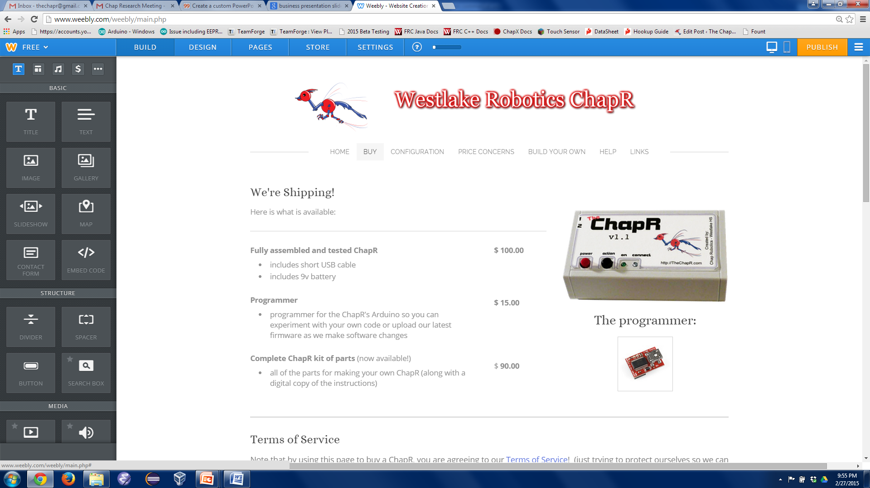
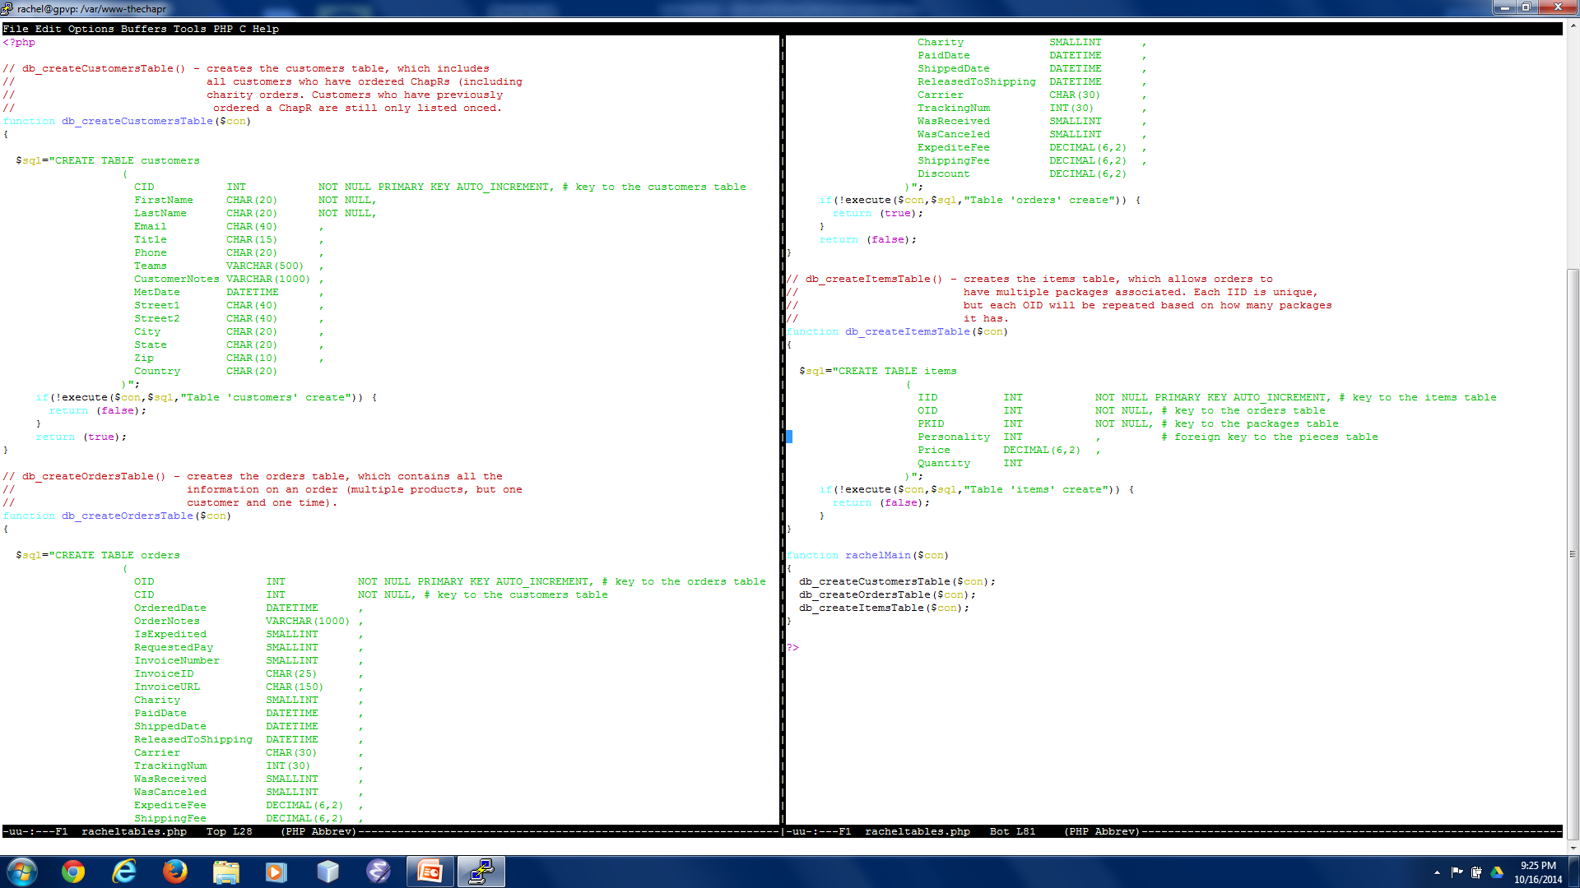
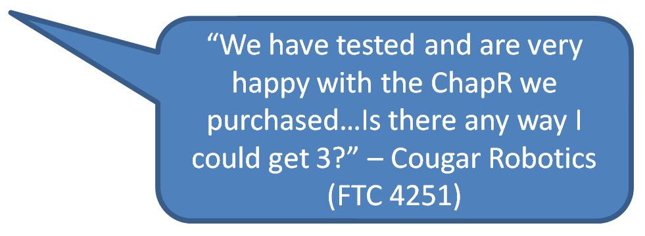
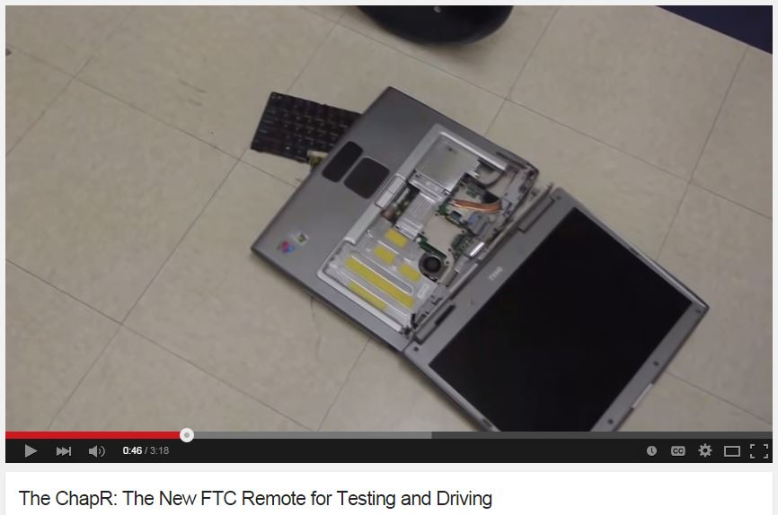
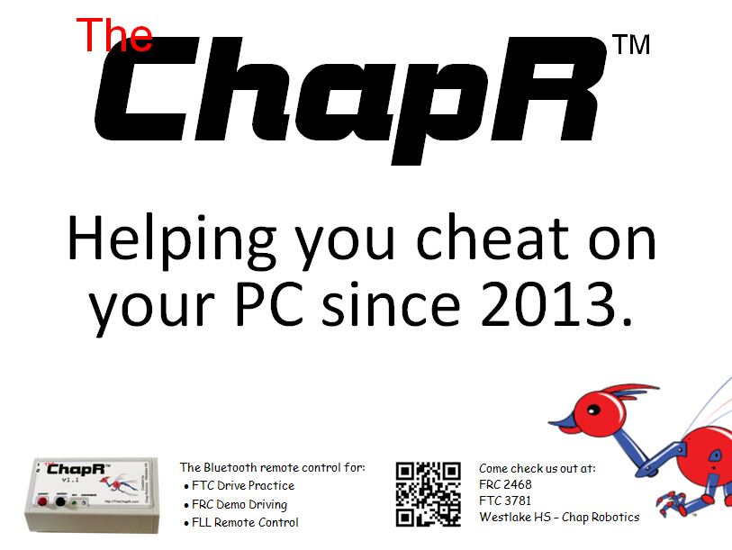
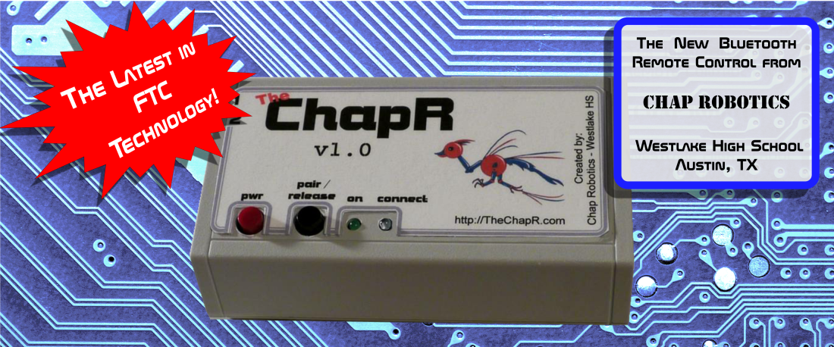
Notes:
Allow me to briefly explain the ChapR project, but keep in mind that the focus is on the process, not the product. While not all projects will be on this scale, the ChapR is an example of the range of skills and experiences we develop.
Whiteboard -

Slide 9
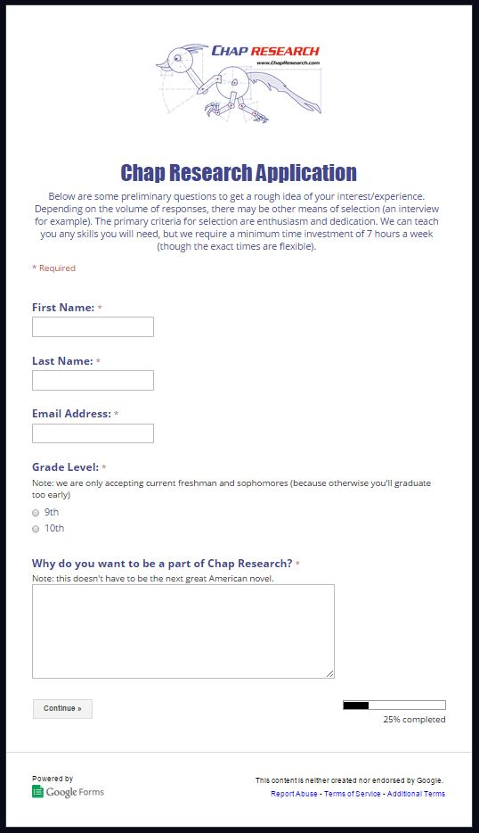
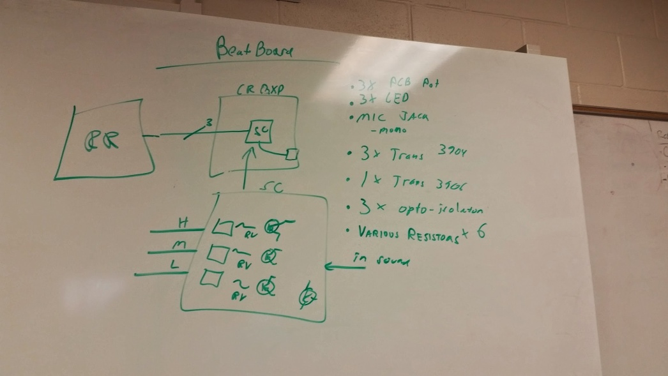
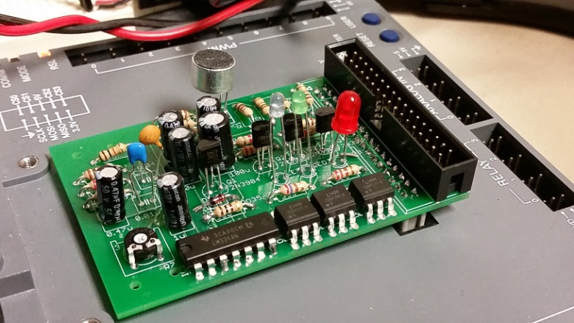
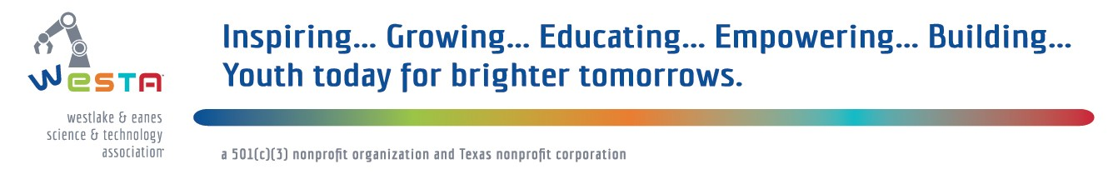
The Vision
Build Chap Research within Westlake High School
Succession planning
Refining business model
Continue developing projects
Expand to other schools
Notes:
Because of this success, we want to continue to build Chap Research within Westlake to …But all this is to just to codify our process within Westlake in order to create sustainable model for other schools. Students have come to us asking how to get started, and our goal within the next 6 months is to be at a point where we can support a beta site within their school or community. Beyond that, we want to establish a partnership between secondary education and industry to develop 21st century skills in students across the nation. Because we believe every student should have access to these sort of opportunities.

Slide 10
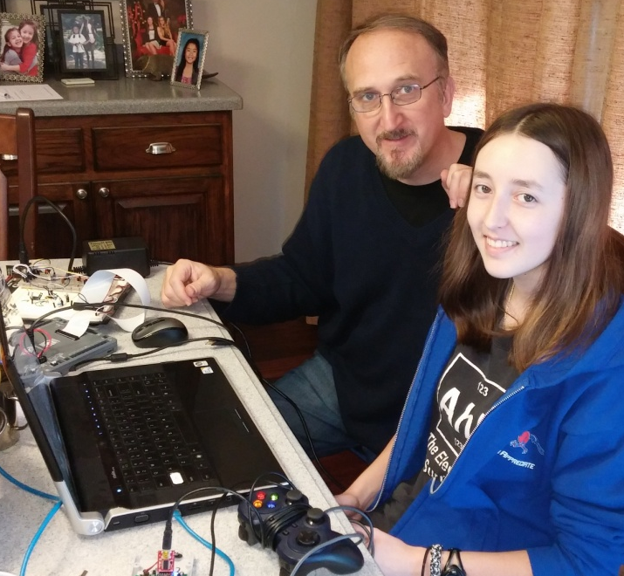
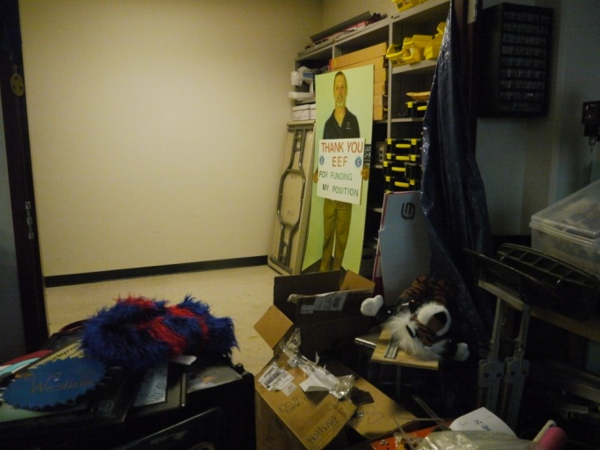
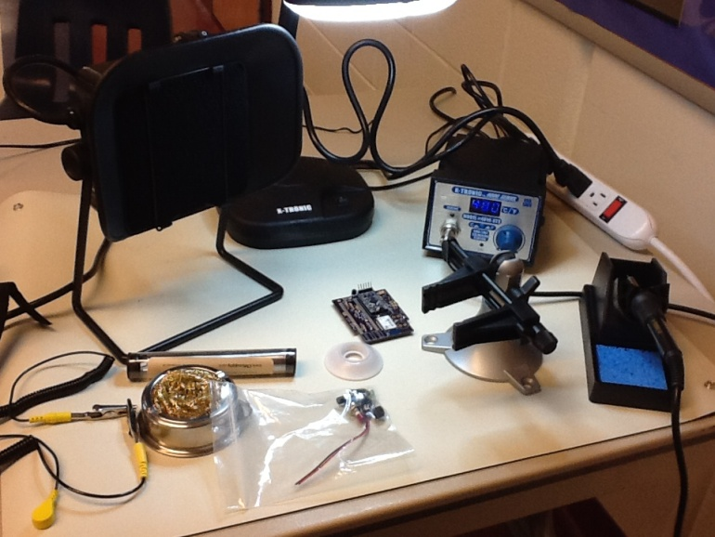
What we need
Financial support
Industry mentors
Facilities
Supplies
Industry connections
Notes:
To accomplish this, we need financial support in order to pay off investors and start up new projects
We need mentors to teach skills and inspire the students both in our local program and in any programs we may found
In addition, while we currently work out of a closet [gestures toward screen], or as I try to get people to call it, we hope to be in a position to provide better facilities and supplies for other programs we found.
Industry connections are also important, because we plan to operate under an advisory board, creating an industry partnership in order to both provide resources and link students to mentors in the community. The industry focus also validates the skills we are teaching, making sure students are learning skills that will be relevant in the work force.
With this help, we will continue to strive toward bridging the gap between high school education and business reality.

Slide 11
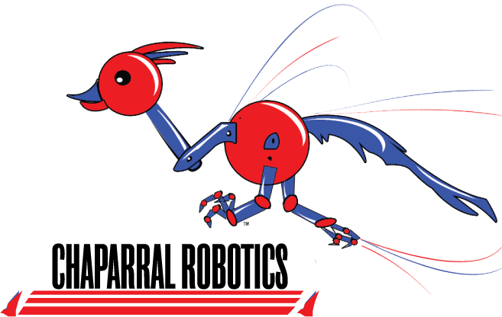

Thank You
Special Thanks to:
For more info:
Chap Research - www.ChapResearch.com
The ChapR – www.TheChapR.com

